Slide 1
STOCK PRICE PREDICTION
GROUP MEMBERS
Ankur Nahar (ID: 14201049, Sec-1)
Sharmin Sultana Moury (ID: 13201017, Sec-1)
Safoan Bin Rashid (ID: 13201020, Sec-2)
Nakib Ahmed (ID: 13201019, Sec-2)

Slide 2
CONTRIBUTION OF DIFFERENT MEMBERS
Dataset Analysis: ANKUR NAHAR
Algorithm Analysis: SHARMIN SULTANA MOURY
Coding, Libraries, and IDE Setup: SAFOAN BIN RASHID
Errors and Result Analysis: NAKIB AHMED

Slide 3
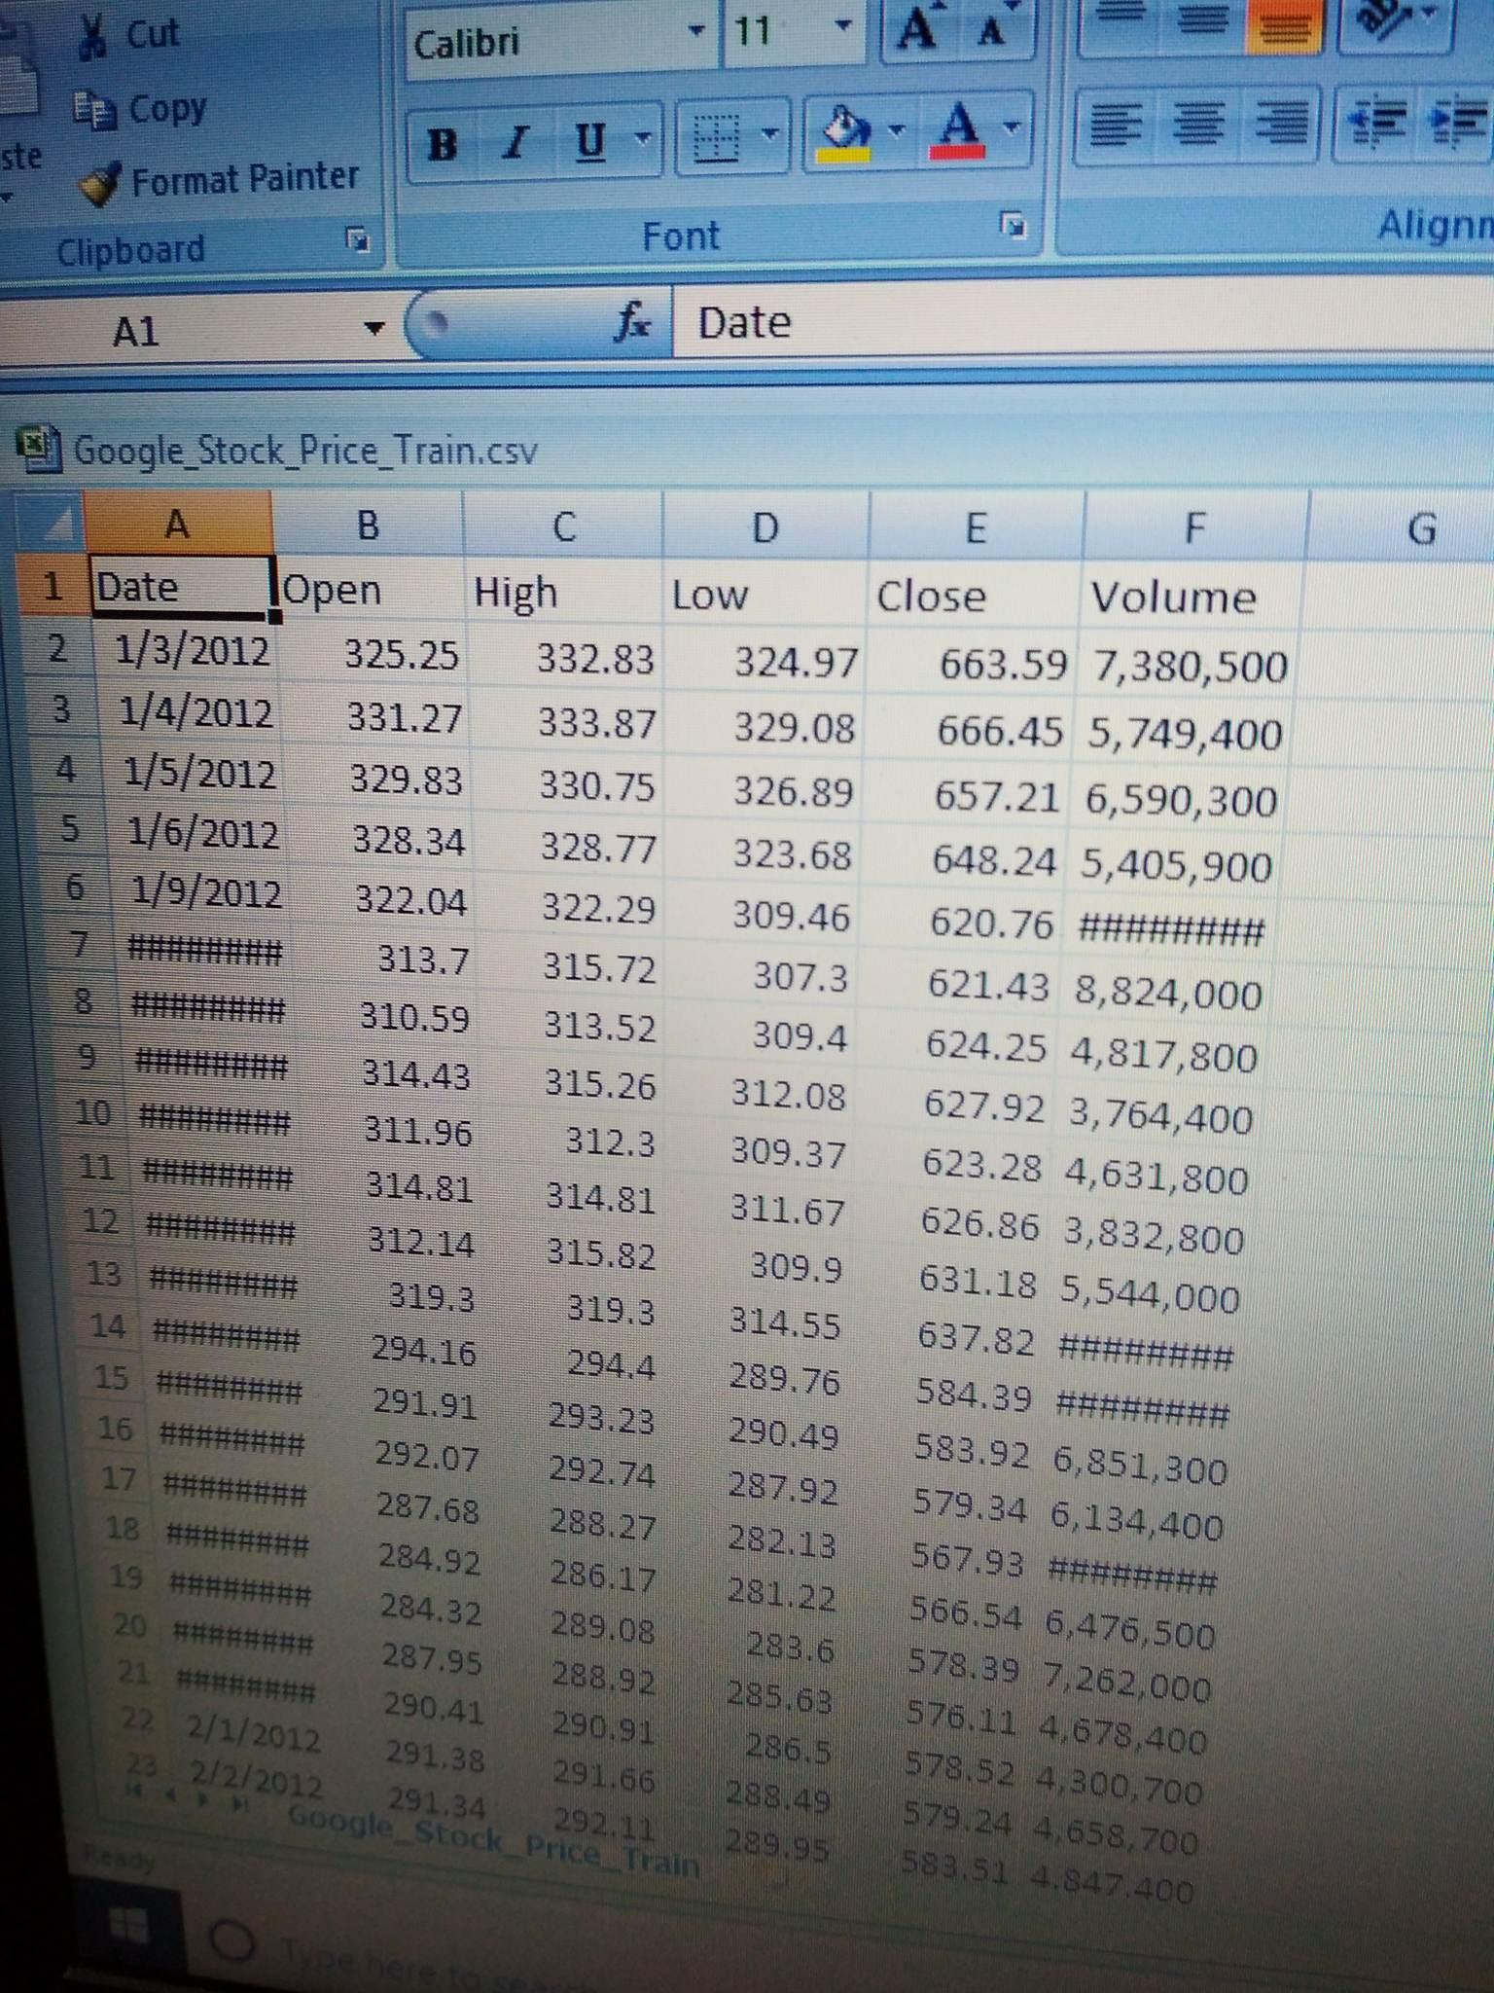
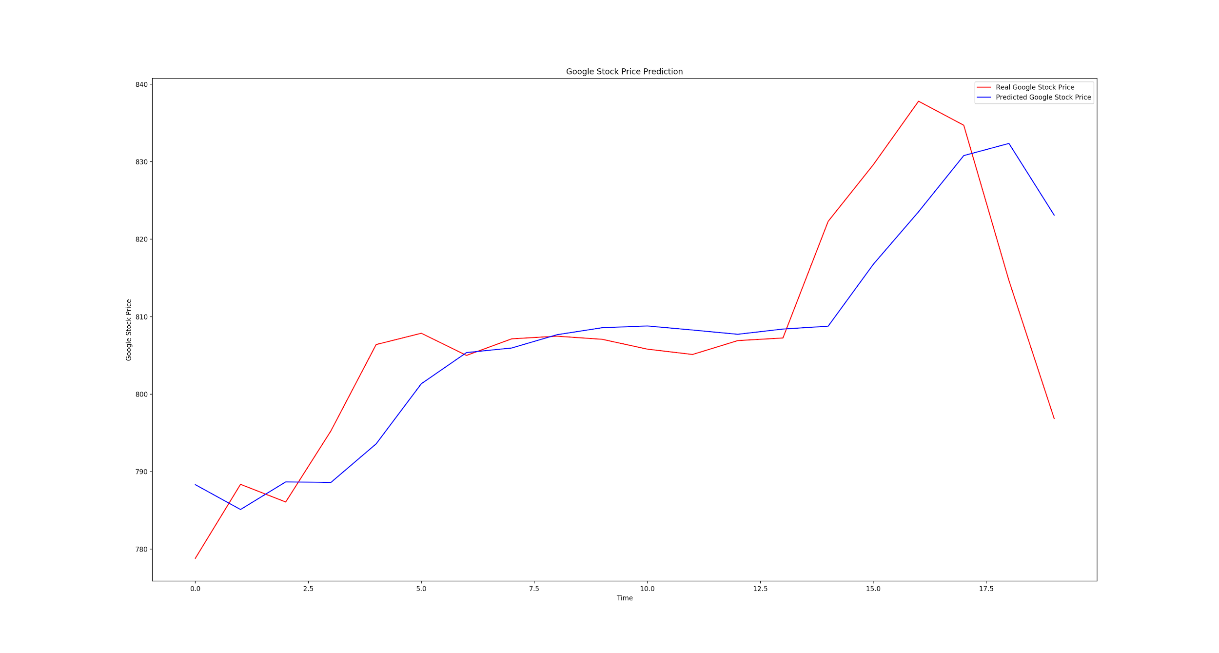
DATASET
For this project we collected the available Google stock price data in the form “Gooogle_Stock_Price_Train.CVS”.
The dataset consists of data from the year 2012, until 2016 in matrix form
The dataset consists of relevant num, date, real price, high price and low price information
Dataset size: (6 columns and 1258 rows)
For this assignment, our main focus was real price

Slide 4
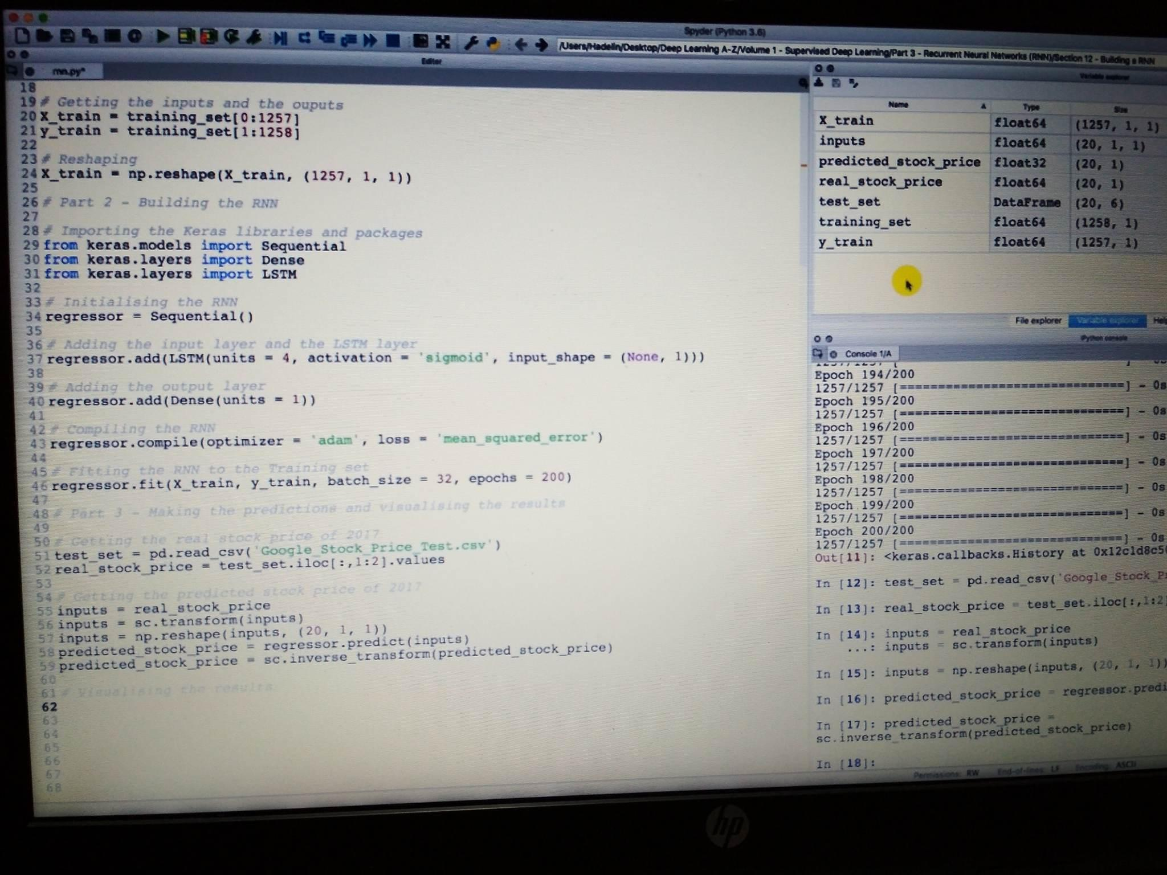
ALGORITHM AND CODING
Our project covers RRN and data analytics
LSTM(long short-term memory), Sequential, Dense and Regression algorithms were required in this project
The RNN (recurrent neural network) takes a three dimensional array as input, and outputs a two dimensional array of predicted stock prices

Slide 5
LIBRARIES
Ample resources are attainable for prediction using recurrent neural network, as it is a popular topic for research
The libraries that were used in this project: Nympy, Matplotlib, Pandas, Sklearn
The model that was used: Keras

Slide 6
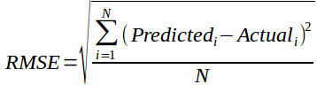
ERROR
To calculate the mean sequential error, Sklearn library was used for root mean square.
RMSE Formula:
RMSE calculated: 0.00214
Data Loss: 2.3x10^-4

Slide 7
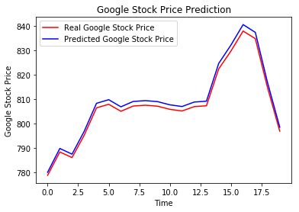
RESULTS
Figure: Initial prediction

Slide 8
Figure: RNN 20 timesteps 1 LSTM Layer

Slide 9
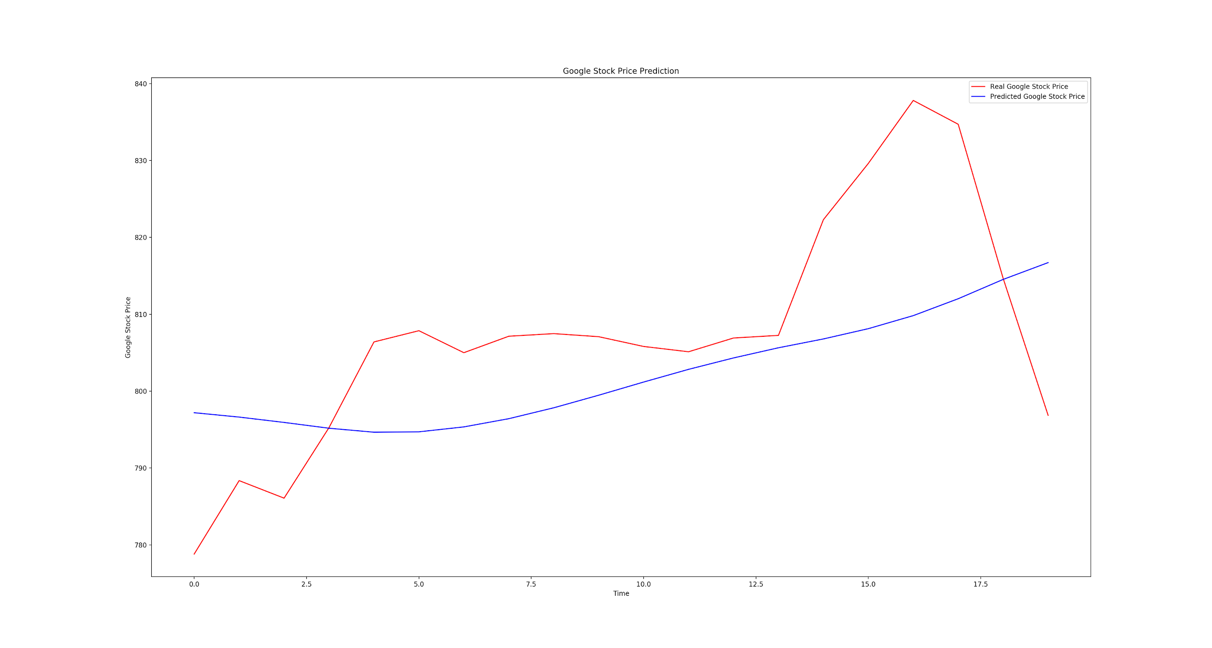
Figure: RNN 20 timesteps LSTM layer

Slide 10
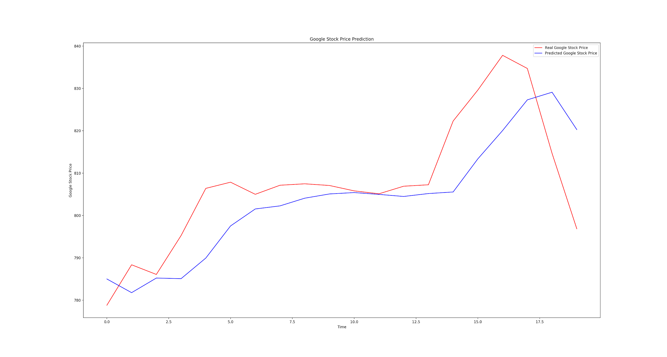
Figure: RNN 60 timesteps LSTM layer

Slide 11
Reference
1.Rakhi Mahant, Trilok Nath Pandey, Alok Kumar Jagadev and Satchidananda Dehuri optimized Radial basis functional neural network for stock index prediction, I international conference on electrical, and optimization techniques (ICEEOT)-2016
2. Kai Chen, Yi Zhou and Fangyan Dai- ALSTM-based method for stock returns prediction: A case study of China stock market, IEEE International Conference on Big Data, 2015.
3. A.U.S.S pradeep, Soren Goyal, J.A Bloom, I.J.Cox and M.Miller- Detection of statistical arbitrage using machine learning techniques in Indian Stock market, IIT Kanpur, April 15, 2013.
4. Prashant S. Chanav, Prof. Dr. Shrishail. T .Patil- Parameters for stock market prediction, I Prashant S Chavan st al, Int.J.Computer Technology & Applications, Vol 4(2), 337-340.
5. Neelima Budhani, Dr. C. K. Jha, Sandeep K. Budhani-Prediction of stock market using Artificial Neural Network, I International Conference on soft computing techniques for Engineering and Technology(ICSCTET)-2014
6. Sharvil Katariya, Saurabh Jain -stock price trend forecasting using supervised learning methods.

Slide 12
THANK YOU

